Slide 1
Using PPTools Narrator
Easily import audio into your PowerPoint

Slide 2
Process Info
Owner name
Team
Resources
Tools
Description
 | AU Member | AU Member | AU Member | AU Member | AU Member | AU Member | AU Member | AU Member | AU Member
Date

Slide 3
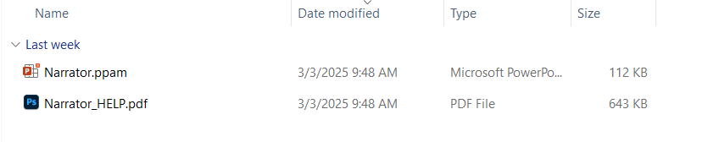
Install Narrator
Install Narrator
Extract the Narrator files (Narrator.PPAM and Narrator_HELP.PDF) to any convenient folder. We suggest your Add-ins folder:
C:\Users\[Your_User_Name]\AppData\Roaming\Microsoft\AddIns
(Substitute your actual Windows user name for [Your_User_Name])
Start PowerPoint and choose File | Options | Add-Ins
Choose Manage: PowerPoint Add-Ins then click Go.
In the Add-Ins dialog box that appears, click Add.
If necessary, browse to the folder where you've saved the Narrator files.
Select Narrator.PPAM and click OK.
Click OK again to dismiss the Add-Ins dialog box. Click the ABOUT button and enter this information: Name: FRIEND OF PPTOOLS Number: 12625804716

Slide 4
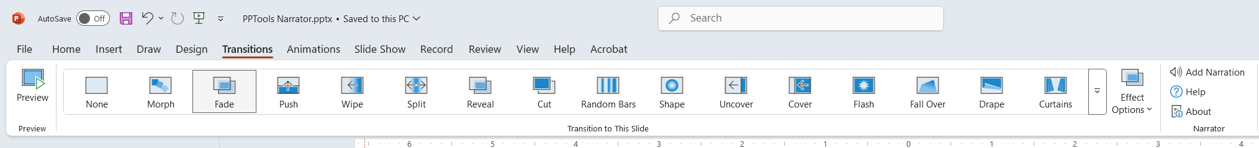
Installation Verification
After installation is complete, go to the Transitions tab and look for the Narrator panel
Click the ABOUT button and enter this information: Name: FRIEND OF PPTOOLS Number: 12625804716
The PDF that comes with the zip is very useful

Slide 5
Import Audio

Slide 6
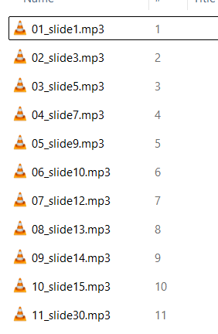
Before importing audio, your file names need to be normalized. Elevenlabs delivers files with preceding characters. Those have to be removed.
Press the Windows key and type CMD, press enter.
CD to your media directory
Run the REN below (it is “ + 3 spaces)
Run the FOR below
REN *.* “ *.*"
FOR %v IN (*.mp3) DO REN "%v" %v

Slide 7
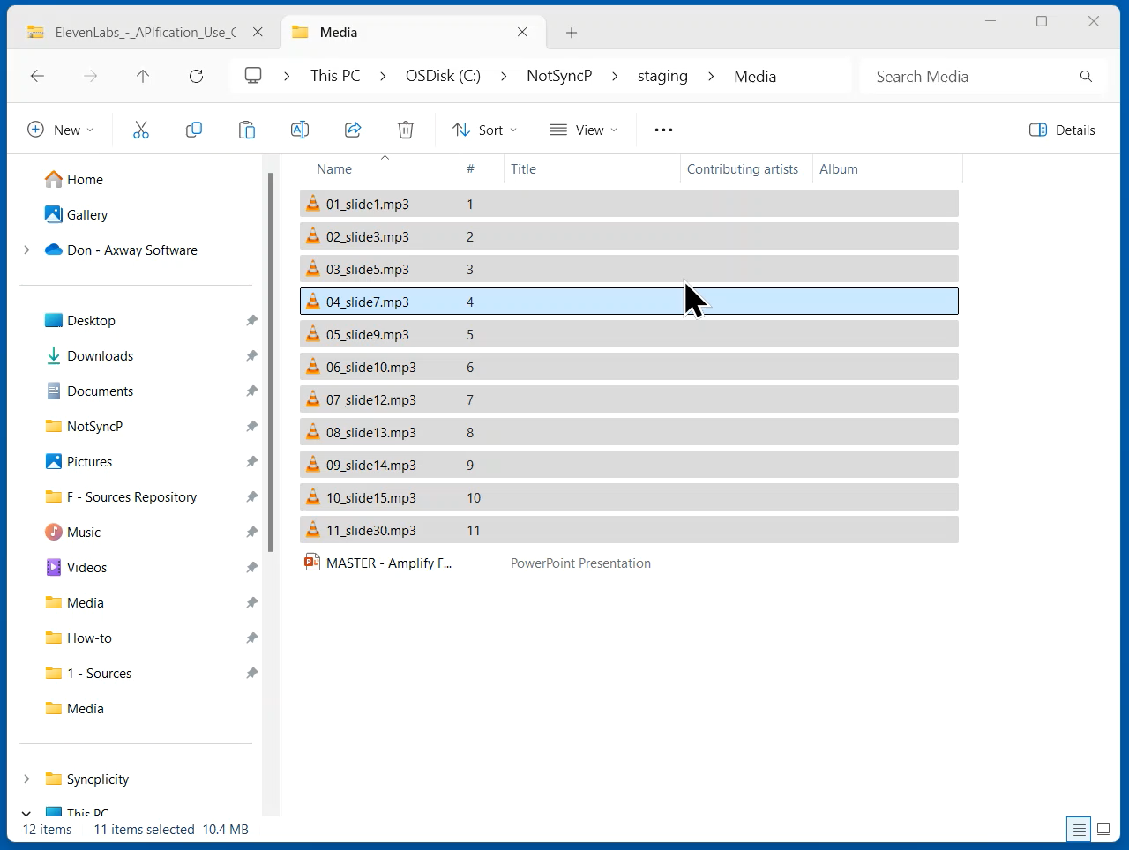
Select the path from the address bar and copy
Open a CMD prompt and type CD then press ctrl V to paste in your path. Press enter.
Press dir, then enter, to see your files.
Type ren *.mp3 “ *.mp3” (that is 3 spaces after the double quote), press enter.
Type dir, press enter to see your files with the extra space at the beginning.
Type: FOR %v IN (*.mp3) DO REN "%v" %v (or paste), then press enter.
Type Exit and press enter to close the CMD prompt.

Slide 8
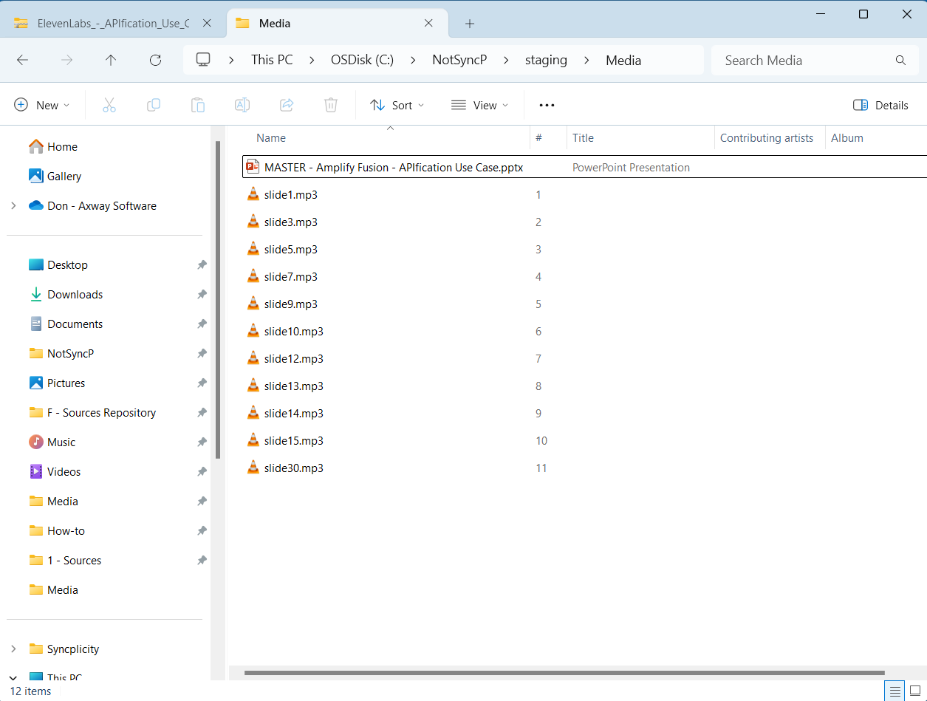
Make a copy of your deck that needs the audio imported and COPY it into the folder containing your renamed media.
Open your deck.
NOTE: This has to be completed on the local computer. The import process will not work in a media folder that lives in OneDrive.

Slide 9
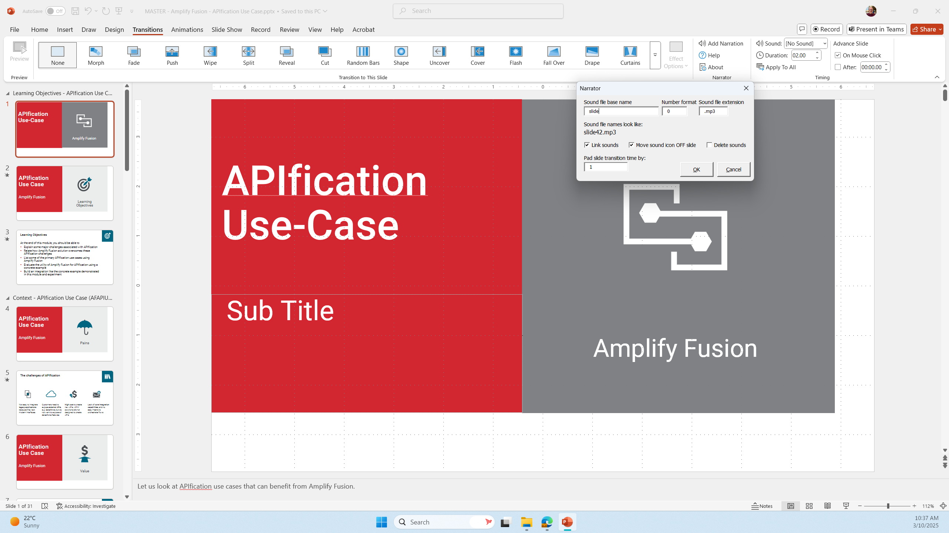
1
2
Click Transitions
Click Add Narration
Set up import like this
Click ok
You can remove all audio that you have attached by using the Delete sounds option.
3
4

Slide 10
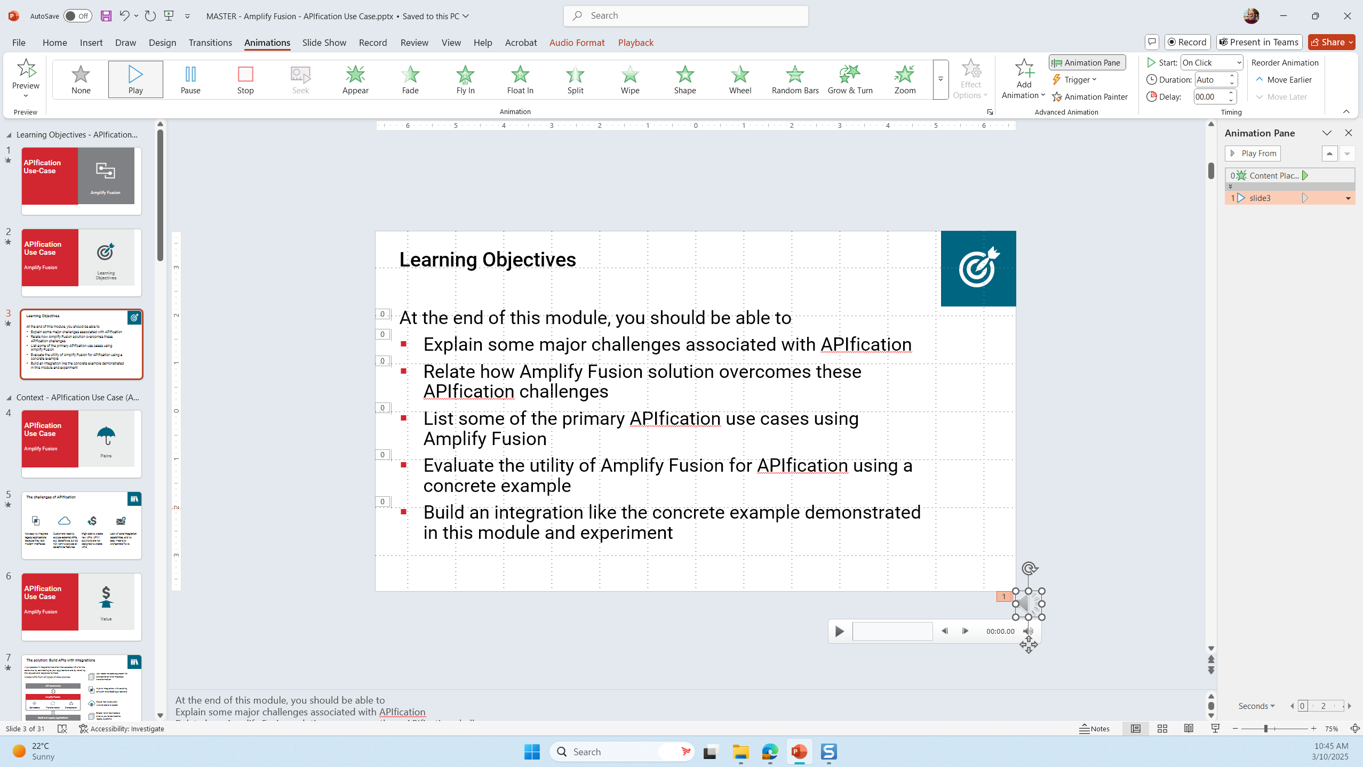
The audio gets attached in the lower right corner. You will still have to set it to start after previous.

